Slide 1
Base line and New model ROC
Notes:
Dantong Yu, Yu Sun

Slide 2
Paths for Baseline model
Auto encoder model
/home/hrchen/HFMLTrigger/Unet_epoch_20_batch_4.hdf5
Classification model
/home/hrchen/HFMLTrigger/Classify_epoch_100_batch_4.hdf5
srv365-19.cewit.stonybrook.edu

Slide 3
New model on 50 epochs
Trained on 8 samples where as the baseline model is trained on 2 samples
Inference can be run using those note book from the below path on server 19:
/home/sriram/Inference

Slide 4
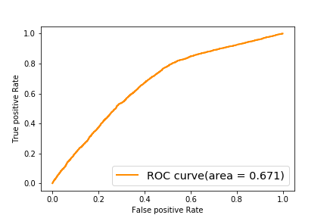
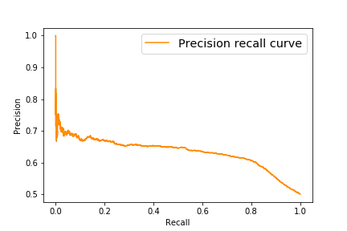
ROC curve for Baseline model

Slide 5
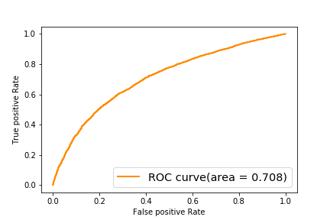
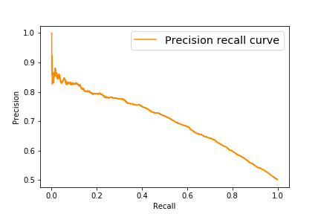
ROC curve for New model
Notes:
Test samples are new and taken from 250 to 300 in the data set.

